Slide 1
Paris in France
Dorota Zdybał

Slide 2
Paris is the capital of France
There are 2mln
Parisians in Paris.

Slide 3
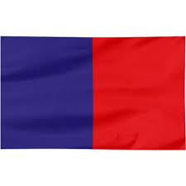
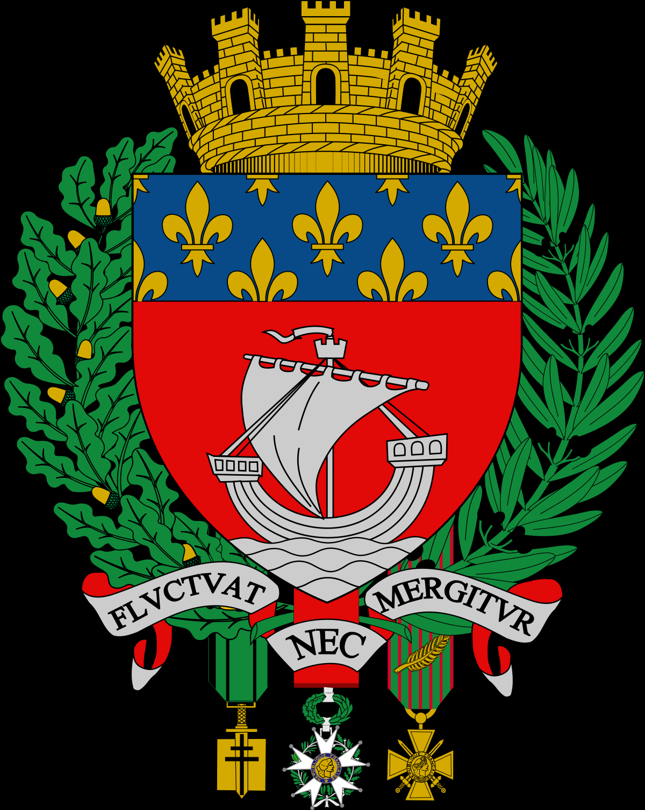
Flag in Paris and arms for paris
flag
arms

Slide 4
Regional food
Snails stuffed with spinach
Oysters and musels
Roasted chestnuts
Chesse
French macaroons

Slide 5
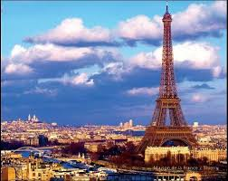
Monuments
EIFFEL TOWER
LOUVRE
CATHEDRAL NOTRE DAME
TRIUMPHAL ARCH
PALACE OF VERSAILLES
MONTMARTRE
ETC…

Slide 6
EIFFLA TOWER
324 metres high
Built in 1889
Restaurant on 2nd flood
Three Viewing terraces
Designer Gustawe Eiffel
taking photos at night is illegal

Slide 7
LOUVRE
The museum is the heart of Paris
Most popular; Mona Lisa painting by Leonardo Da Vinci next to the picture there is mailbox where you can throw love letters
Luwr been aabandones
1989 built the Luwr
21metres high
In Louvre you should look at Michaelangelo, Rafael, Caravaggio
works of art

Slide 8
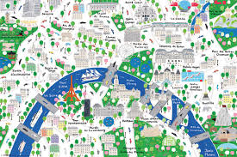
Maps

Slide 9
Thank you for look my project
Dorota Zdybał
WEBCAME; WIKIPEDIA

